Slide 1
Guide to Performing a Root Cause Analysis:
A companion slide set for field education

Slide 2
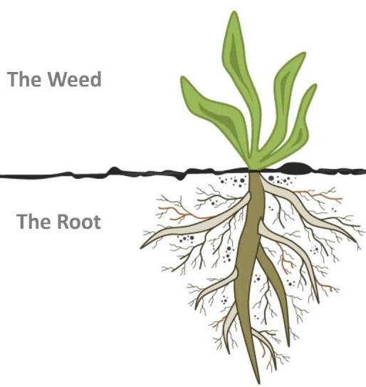
Introduction
RCA Guidebook, p 4
Patient safety events can cause serious harm or death.
System and process flaws cause most failures and require systematic investigation and analysis to unearth root causes and develop solutions.
Most common comprehensive systematic analysis: Root Cause Analysis (RCA).
  Process to identify basic causal factor(s) underlying system failures (the root; source below surface; obscured)
  Adverse outcomes, sentinel events, or clusters of less serious incidents or near misses (the weed; problem above surface; obvious)
Notes:
RCAs help organization understand and respond to the contributing factors and interrelationships of those factors when developing and implementing action plans to correct vulnerabilities and fortify systems to protect patients, staff, and organizations against potential and actual harm.

Slide 3
Purpose of the Guidebook
RCA Guidebook, p 4
To describe process steps to complete an RCA according to protocols found in:
  Veteran Health Administration (VHA) Patient Safety Program
  VHA Patient Safety Handbook 1050.01
To identify intended users of the guidebook and those involved in RCAs
To provide definitions for key terms, RCA examples, information about Aggregate Review RCAs, and the RCA Quality Analysis Tool (QAT) in multiple appendices

Slide 4
Determining When an RCA is Required
RCA Guidebook, p 5
Sentinel events, serious safety event (SE), any event with a substantial, direct, and high probability that a serious SE would have ensued, but did not, due to intervention/chance
Events with a Safety Assessment Code (SAC) of Actual or Potential 3
Falls, Missing Patient, Medication Events with Potential 3 SAC
  Do not require an individual RCA; may be done at discretion of facility
  Aggregate and analyze together or review for inclusion in Patient Safety Assessment Tool (PSAT)
All RCAs must be formally chartered and signed by facility Director.
Notes:
Safety Assessment Code (SAC):
Process of analyzing adverse events and close calls to determine if a RCA, aggregate review, or other action will be completed
Categories to rate adverse events and close calls/near misses: Severity and Probability
SAC Matrix: a grid used to pair severity and probability to obtain a SAC Score
SAC Score – Risk Score: 3=high risk, 2=intermediate risk,1=low risk
SAC 1 or 2 events: based on topic/needs of facility: evaluate through individual or Aggregate Review RCA
Actual SAC 3 events (what really happened): Individual RCA required
Potential SAC 3 events (what may have happened; what could happen in the future):
Aggregate and analyze together example: annual Mediation Aggregate Review RCA
review for inclusion in PSAT: annual Falls PSAT; Wandering and Missing Patient PSAT

Slide 5
Characteristics of a Root Cause Analysis
RCA Guidebook, p 5
Adhere to procedures in RCA Guidebook and charter memorandum
All documents must have the term “Root Cause Analysis” to be protected/confidential:
  38 U.S.C. 5705
  Implementing regulations (VHA Directive 2008-077, Quality Management (QM) and Patient Safety Activities that Can Generate Confidential Documents)
NOT protected: email or RCAs if RCA charter memorandum unsigned by facility Director
Notes:
Within 45 days of facility becoming aware that an RCA is required, RCAs MUST be:
Completed,
Signed by facility Director or designee, and
Documented in SPOT.
See Figure 1. RCA Process Steps (p 6): Root Cause Analysis Flow Diagram

Slide 6
Characteristics of a Root Cause Analysis
Within 45 days of facility becoming aware that an RCA is required, RCAs MUST be:
  Completed,
  Signed by facility Director or designee, and
  Documented in SPOT
Follow the process steps provided in the RCA Guidebook and explained more fully in subsequent sections and appendices
Notes:
See Figure 1. RCA Process Steps (p 6): Root Cause Analysis Flow Diagram

Slide 7
Root Cause Analysis Flow Diagram
RCA Guidebook, p 6
The crucial process steps in the Root Cause Analysis include:
  Getting Started day 1 thru 14
  Analysis 15-45 days
  Feedback
  Implementation and Measurement

Slide 8
Completing an RCA, Step 1: Charter a Team
RCA Guidebook, p 7
Composition (4-6 members): Leader, Advisor, Subject Matter Expert (SME), non-SME
  Large enough for diverse viewpoints and opinions
  Small enough to keep meetings manageable
Describe professional titles and specific roles of individuals on RCA team in charter and may also be included in charter memorandum
Recorder needed to document meeting notes, interviews, Q&As, and guide next steps
Notes:
Example depiction of team membership included on page 7 of RCA Guidebook.
Recommendation: Patient Safety Managers (PSMs) NOT lead an RCA but remain available as a facilitators/advisors for the groups

Slide 9
Completing an RCA, Step 2: Conduct Just in Time Training
RCA Guidebook, p 8
Conduct RCA team training with every RCA event, even if no new members are present.
  Senior leader greeting shows tangible executive leadership support for RCA team
  Just in Time Training Video (run time 18:27)
Just in Time Training should include: an overview of the RCA process; information on confidentiality, timeline of the process, roles and responsibilities of team members, event briefing, and milestones with meeting dates/times established at first meeting.
Notes:
Suggestion for audience: Review the examples and additional details presented on page 8 of the RCA Guidebook and customize the information to the process already in place in learners’ facilities.
Just in Time Training Video: RCA SEQ 180301d (run time 18:27) located at https://bcove.video/2F7cCCP; and, at https://players.brightcove.net/pages/v1/index.html?accountId=2851863979001&playerId=rJR8SfOyf&videoId=5743428413001

Slide 10
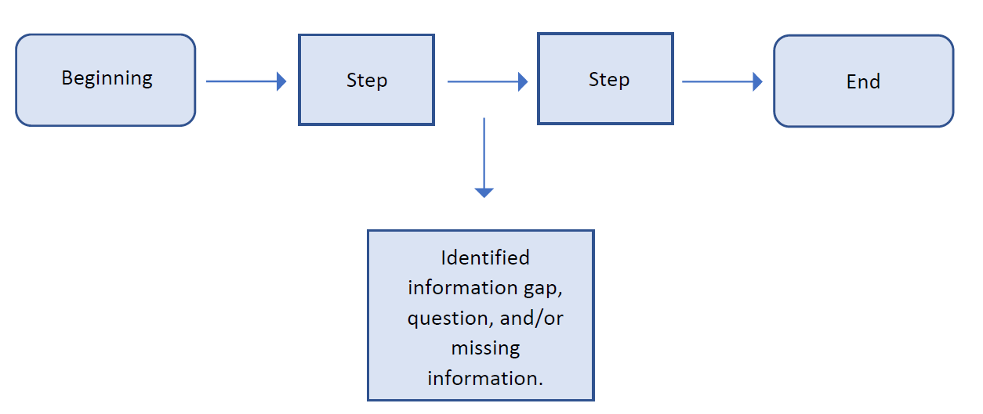
Completing an RCA, Step 3: Create the Initial Flow Diagram
RCA Guidebook, p 9
  Graphically documents known and relevant facts of the event
Notes:
The Initial Flow Diagram is the visualization of each known process step up to the point in which the system failure occurred. It is an RCA process step that forces the team to lay out known and relevant facts of the event, both graphically and chronologically. While there is no single correct way to illustrate the Initial Flow Diagram, normally, this is accomplished using text within shapes and arrows.
Some additional tools include process maps, swim lane diagrams, post-it note boards, mind maps, cause and effect diagrams, fault trees, and event trees.
The diagram represents the initial work of the team as they determine each step in the event, where each step is expressed in broad, rather than granular, language. Ultimately, the steps should sequentially flow from one step to the next, to allow a full understanding of what transpired and what elements of the system require improvement.

Slide 11
Notes:
Example

Slide 12



Notes:
As the team lays out the Initial Flow Diagram and views it in its entirety, it will become apparent that some steps that contribute to understanding systems issues may have been omitted; therefore, additional information will be required to close gaps in knowledge. The Initial Flow Diagram also enables the team to answer the “where” and “how” to obtain missing information as well as assists the team in identifying the areas of the facility that need to be visited, what processes might be simulated, what documents require review, and who should be interviewed.

Slide 13
Completing an RCA, Step 4: Craft the Initial Understanding
RCA Guidebook, p 10
  Narrative expression of the Initial Flow Diagram
  Adds greater detail of events
    Staffing, equipment, products, environmental, or other influencing factors
  Discovers the facts
    Asks “why” for each item in the flow diagram
    Identifies missing pieces
  Identifies resources
    Policies, medical records, or committee minutes
    Determines who to interview
Notes:
The Initial Understanding is a narrative expression of the RCA team’s work that produced the Initial Flow Diagram. This means that the Initial Understanding may explain information in greater detail than is possible in the stepwise display in the Initial Flow Diagram. The Initial Understanding should be viewed as separate from, and complimentary to, the Initial Flow Diagram.
The team should first learn about the context of the event, including staffing, environmental and other influencing factors or data points. This critical work involves understanding and defining what factual events took place leading to an adverse event. By objectively investigating what happened, the team may find missing information that changes the understanding of the event and in turn, helps the team more accurately connect the dots.

Slide 14
Completing an RCA, Step 5: Identify Information Gaps
RCA Guidebook, p 11
  Determine missing information
  Gather data related to the event
  Identify system and process vulnerabilities
  Visit the scene of the event
  Simulate event if possible
Notes:
While drafting the Initial Understanding, keep the team on task by using a “parking lot” for questions that arise that are not directly associated with the event but may require analysis at a later time. Determine what information is missing or needed for complete understanding of the event by:
• Gathering data to gain understanding of the event, the causal factors, and associated root causes.
• Ensuring consistent use of the Triage Questions, discussed below, to identify system and process vulnerabilities. This allows for continued focus on environmental factors and systems rather than people.
• Continuing to gather data until the team establishes a clear understanding of the event and the existing factors that led up to it.
• Visiting the scene of the event and using the event related equipment, if possible, to safely simulate what happened.
A thorough review of available information will allow the team to determine what is not known about the event and what information still needs to be discovered.

Slide 15
Completing an RCA, Step 6: Use Triage Questions
RCA Guidebook, p 11
  Standard set of questions
  Assists the team in considering areas of inquiry
  Reveals vulnerabilities in systems and work processes
  Link to Triage Questions
Notes:
Triage Questions are a standardized set of questions that help to ensure the team is carrying out a comprehensive inquiry. All triage questions should be addressed by the RCA team. Triage Questions are answered either “yes”, “no”, or “not applicable”; each of these answers assumes that the question asked was earnestly considered/addressed by the team and is acceptable. Triage Questions may be applied when the team builds the Initial Flow Diagram; however, they can also be referenced throughout the RCA process. As the team analyzes the event, they may naturally develop some of their own questions to augment the standardized Triage Questions. These “team questions” should be combined with the standardized Triage Questions to conduct the investigation and interviews.

Slide 16
Completing an RCA, Step 7: Collect Resources and Prepare for Interviews
RCA Guidebook, p 12
Identify team members to obtain and review documents
Identify individuals to be interviewed
Determine interview date/time and location
Draft interview questions
Notes:
As a team determine documents you feel appropriate to obtain and review. Identify which team members will obtain and review which documents. Examples of documents for review may include policies, procedures, reports, regulations, directives, medical records, and manufacturers’ literature. Establish goals and deadlines to complete the review.
The review should be of current regulatory guidelines, evidenced based practice guidelines, current policies or directives that help your understanding of what should have occurred to help guide your investigation. It could also help in the developing questions for the interviews. If you understand what should have happened, you can target the “why” it wasn’t done. What barriers, process issues or knowledge gaps occurred that led to the event.
These documents will help you understand “work as imagined” versus “work as done”

Slide 17

Completing an RCA, Step 8: Conduct the Safety Investigation
RCA Guidebook, p 12
Notes:
You will be asking the What, Where, When, How and Why but NOT the Who for steps 7 and 8 of the RCA process. Remember the focus is on the system and not the individual
The team will identify the gaps in knowledge as well as attempt to understand “work as done” versus “work as imagined” including but not limited to using established policies, Directives, protocols, evidence-based practice, industry standards, interviews, pertinent records.

Slide 18
Completing an RCA, Step 8: Conduct the Safety Investigation
Develop a strategy to “fill in the information gaps” including but not limited to:
  Review pertinent documents
  Interviews
  Simulate the event
    “…simulation and debriefing in event analysis helped identify multiple, underlying causes of teamwork errors, latent risk factors (things that make errors more likely), and more specifically system errors in surgical cases.” ^{Lobos & Ward, 2019}
  Literature review
    determine evidence-based practices
    prevalence of incidence
  Data pull
    JPSR
    SPOT
Notes:
Review Pertinent Documents: As a team determine documents you feel appropriate to obtain and review. Identify which team members will obtain and review which documents. Establish goals and deadlines to complete the review. These documents may include but not be limited to current Policy, SOP, Directives, reports, pertinent medical records, Regulations, Manufacturers’ literature. These documents will help you to develop interview questions.
Interviews: Identify individuals to interview. Select a date, time and location agreeable to all parties. Develop and organize your questions in advance to help keep on task. Reinforce that the process is not punitive and is protected and privileged under 38 U.S.C. 5705. Encourage individual to tell their story and thank them for sharing it.
Simulation: Recreating the event with original individuals. This study showed that there was an increase in the discovery of errors compared to traditional adverse event investigation.
Literature review: will help determine current evidence-based practice and prevalence of an incident. This may help with developing action plans later in the process.
Data Pull: Utilize NCPS to pull and deidentify related events in JPSR and SPOT. This will help you better understand the prevalence of the event and potentially lessons learned to help with action plans later in the process.

Slide 19
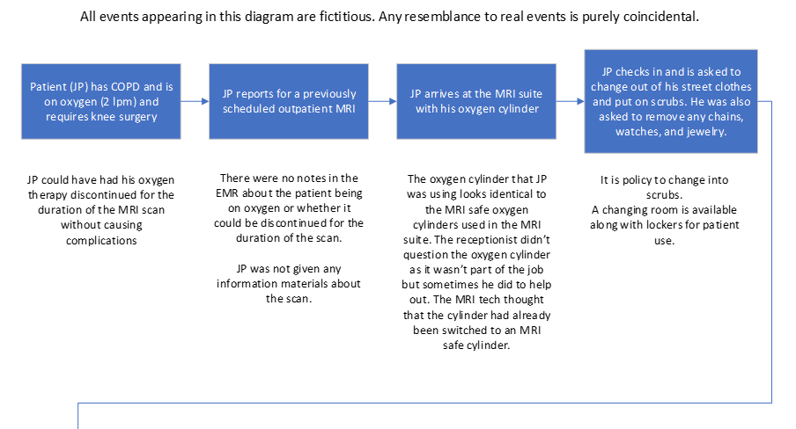
Completing an RCA, Step 9: Create the Final Flow Diagram
RCA Guidebook, p 13
The Final Flow Diagram is a graphic of the first known relevant fact through the final known relevant fact. It is developed using all the information obtained in fact finding investigation.
Notes:
The Final Flow Diagram follows the same graphic constructs used for the Initial Flow Diagram – that is shapes, arrows, and text. Because the Final Flow Diagram is constructed from the investigative work completed by the RCA team (interviews, simulations, document reviews, literature review, and analysis), it is markedly different in detail and appearance from the Initial Flow Diagram. Once the final flow diagram is complete, the RCA team will be able to view the event in its entirety and compare what happened to what should have happened. The team is able to visualize the deviations, formulate an understanding, and answer why deviations occurred. If further questions arise, the team may need to do more investigative work, such as follow up interviews or document review for clarification.

Slide 20
Completing an RCA, Step 10: Create the Cause-and-Effect Diagram
RCA Guidebook, p 15
Required!
What is a cause-and-effect diagram?
  Systematic method
  Determines causal links
  Shows starting point and represents:
    Preventing problem from:
      Occurring (e.g., near miss)
      Recurring (e.g., a fire happened)
Notes:
A Cause-and-Effect Diagram is a systematic method of determining causal links, showing a primary effect of consequence,
This helps to reduce finger pointing and placing blame on any one person.
Helps identify barriers

Slide 21
Completing an RCA, Step 10: Create the Cause-and-Effect Diagram
Work backwards with "caused by" statements
  For specific actions
  For specific conditions
Keep working backwards until you can’t!
Notes:
Work backwards with "caused by" statements for specific actions and conditions until a reasonable preceding cause or contributing factor can no longer be identified.

Slide 22
Completing an RCA, Step 10: Create the Cause-and-Effect Diagram
RCA Guidebook, p 16
ACTION Light a match
PRIMARY EFFECT-CAUSE CONDITION
PRIMARY EFFECT OF CONSEQUENCE/ PROBLEM STATEMENT
FIRE!
CONDITION Oxygen
CONDITION Ignition Source
CONDITION Combustible Material
Notes:
Now put the final understanding into a diagram. The lines represent “Caused by” or “Why did this occur” moving from the single problem statement to many actions and conditions
Ask “How did this happen?” Or “What caused this?”. While a picture can be worth a thousand words, you don’t need to be too complicated nor to simple.
The problem (or the Primary effect) is what happened, or the result. The primary effect could be “Patient broke left upper arm” or “Severe tissue necrosis” or “Fluid overload” or “Patient Died”. In this case, it is a house fire!
The Action(s) (think verb) relate to causes that are in motion, or in an active state, are momentary in nature and easily recognizable. In this case the patient (or someone) lit a match.
The Condition(s) (what causes the action to happen) are passive in nature, often unseen or existing quietly in the background. Conditions are things we know about, but frequently don’t receive much thought or consideration under most circumstances and exist over time prior to an action. In this example, we know that oxygen can be combustible if exposed to a flame; however, it may not be a condition we actively think about.
In this case what conditions need to be present for a fire if a match was lit? An ignition source (for instance, an oxygen tank), Oxygen (perhaps from the oxygen “halo” when a person uses an oxygen tank) was present, and oxygen is a combustible material.
OF NOTE: When starting a cause-effect diagram, it is important to identify at least two causes, one an action cause, the other a condition cause for the Primary Effect of Consequence/ problem statement. There could also be more.
The RCA Team keeps asking a “caused by” or a “why” question for each action and condition. Keep going!
The causes may become effects. The team continues to work backwards, each time asking the question “caused by” or “why ‘ identifying additional causes (actions and/or conditions).
This results in an ever-expanding set of causes that can become lengthy or short. No two Cause-and-effects diagrams are the same.

Slide 23

Completing an RCA, Step 10: Create the Cause-and-Effect Diagram
RCA Guidebook, p 17
ACTION
ACTION
CAUSE AND EFFECT DIAGRAMS ARE NOT STRAIGHT FORWARD
ACTION
ACTION
ACTION
ACTION
ACTION
ACTION
ACTION
ACTION
ACTION
ACTION
ACTION
ACTION
PROBLEM STATEMENT
ACTION
ACTION
ACTION
ACTION
CONDITION
CONDITION
CONDITION
CONDITION
CONDITION
CONDITION
CONDITION
CONDITION
CONDITION
CONDITION
CONDITION
CONDITION
CONDITION
CONDITION
CONDITION
CONDITION
CONDITION
CONDITION
CONDITION
CONDITION
CONDITION
Notes:
Not all identified causes and effects fit neatly into a perfectly linear and symmetrical model.
The team may find as they move further backward in causation actions and conditions, there may not always be an identifiable action and condition.
OR there may be multiple actions and/or conditions identified. The team can continue asking “why” to develop the diagram
Cause-and-Effect diagram is a take-off of an example by the National Patient Safety Foundation(2016)

Slide 24
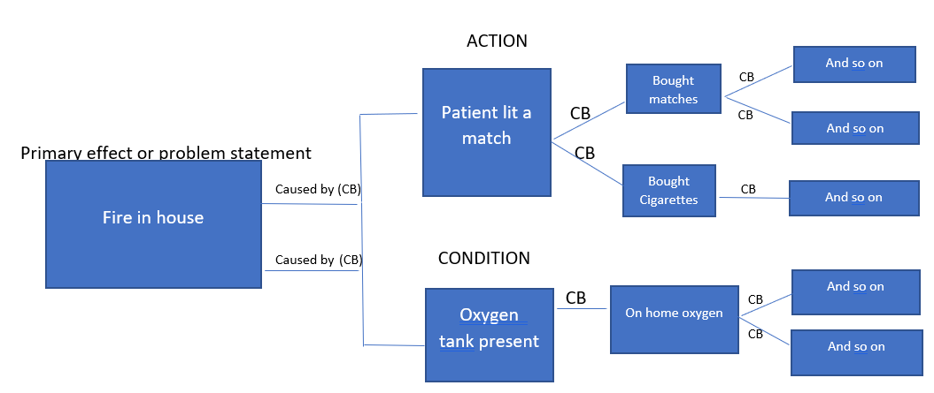
Completing an RCA, Step 10: Create the Cause-and-Effect Diagram
RCA Guidebook, p 18
WHEN DO WE STOP?
Notes:
The question then becomes: When do we stop?
That is why we have an RCA Team made up of different people and possibly from different professions or work groups.
When the RCA Team is committed to finding answers and identifying action and condition causes for each effect, the deeper the team’s understanding of the problem and contributing factors. This adds a richness and ideas we may not have considered.

Slide 25
Completing an RCA, Step 10: Create the Cause-and-Effect Diagram
STOP! When the RCA Team says:
  Who cares?
  We don’t know anymore!
  That’s just how it is!
  Or similar statements..
Notes:
We don’t want to stop too soon!
We don’t want to go to the point of the ridiculous, either. For example, if a condition identified is snowy winter weather, asking why and following through with additional causal inquiries is a fruitless exercise.
When you reach a point when it seems that there is nothing else, STOP!

Slide 26
Completing an RCA, Step 11: Craft the Final Understanding
RCA Guidebook, p 19
Separate from & complimentary to the Final Flow Diagram
Written as a narrative
  Complete understanding of flow diagram
  Includes all work of RCA Team
Begin with first known relevant fact; end with last known relevant fact
Addresses missing information & gaps in knowledge
Helps understand the event and its root cause(s) and contributing factor(s)
Notes:
This is the time to tell the story of what happened and your findings and fill in details that are difficult to include in the process flow mapping
Tell of the known facts from start (first known relevant fact) to finish (last known relevant fact) and include information derived from interviews, simulations, document reviews, literature review, and analysis conducted by the RCA team
To avoid any confusion, this narrative should be written in a chronologic order of the process. For instance, “The RCA Team then found the process for IV dressing changes was not followed because the staff didn’t agree with it, so we looked up any SOP’s, policies and Directives as well as any information available through the INS (Infusion Nurse Society). We also completed a literature search using the keywords ‘IV Dressing Change, IV sites, Intravenous and nursing’.”
Addresses missing information from the JPSR log or patient safety report. Using the IV dressing change issue, this may be the dressing kits were not available on the unit where the incident happen, and Logistics did not have any in stock and were waiting on an order to come in.
Addresses gaps in knowledge identified in the initial understanding, such as staff were unaware of alternative methods of changing an IV dressing and securing the site.
The narrative also assists in understanding the root cause and contributing factor statements that follow the written RCA.

Slide 27
Completing an RCA, Step 12: Identify & Craft Root Cause and Contributing Factor Statements
RCA Guidebook, p 19
Synthesize the RCA team's findings from:
  All previous work
  Depicted in the Final Understanding
Identify what system elements must be improved
Notes:
Root Cause/Contributing Factor Statements (RC/CF) statements must be meaningful, and value added.
RC/CF statements are basically the same.
RC/CF statements should lead the team to identify what system vulnerabilities contributed to the adverse event or close call.
RC/CF answer the questions –“what exactly needs to be fixed and how do we fix it?”
The term “Root Cause” is rarely, if ever, attributed to one causal factor and several factors that influenced the series of events leading to the adverse event or close call may be found. Some factors may have more influence on the event than others.
RC/CF Statements flow naturally from the Final Understanding

Slide 28
Completing an RCA, Step 12: Identify & Craft Root Cause and Contributing Factor Statements
Statements:
  Address causal factors or action plans
    Contribute the most
    Have the greatest impact on the system
    Have potential to prevent recurrence
  Need to
    Lead the team to an appropriate action plan
    Be understood by the cold reader
Use the:
  5 Rules of Causation (reviewed on the following slides)
Notes:
We say “Craft” as this may take some wordsmithing to convey the contributing factors statement for clarity of intent.
The RCA team will select those causal factors (one or more) that rise above others to a point where they require attention and corrective action. It can be thought of as

Slide 29
Completing an RCA, Step 12: Identify & Craft Root Cause and Contributing Factor Statements
RCA Guidebook, p 21
RULE 1: Clearly show cause and effect relationship
  Not compliant: The Pharmacist was fatigued.
  Compliant: Pharmacists are regularly scheduled 60 hours per week, which led to increased levels of fatigue, increasing the likelihood that dosing instructions would be misread.
RULE 2: Use specific and accurate descriptors
  Not compliant: The poorly written manual increased the likelihood that a pump would be programmed incorrectly.
  Compliant: The pump manual had 8-point font and no illustrations; as a result, nursing staff rarely used it, increasing the likelihood that the pump would be programmed incorrectly.
Notes:
RC/CF statements are written in accordance with the Five Rules of Causation based on the work of “NCPS and the Federal Aviation Administration technical report Maintenance Error Causation” by David Marx (1999)

Slide 30
Completing an RCA, Step 12: Identify Root Causes and Craft Contributing Factor Statements
RCA Guidebook, p 21
RULE 3: Human errors must have a preceding cause
  Not compliant: The resident selected the wrong dose in CPRS which led to the patient being overdosed.
  Compliant: Drugs in the CPOE system are presented to the user without sufficient space between different doses on the screen, which led to the wrong dose being selected, increasing the likelihood of an overdose.
RULE 4: Violations of procedures are not root causes
  Not compliant: The techs did not follow the procedure for CT scans, which led to the patient receiving an air bolus from an empty syringe, resulting in a fatal air embolism.
  Compliant: Noise and confusion in the prep area, coupled with production pressures, increased the likelihood that steps in the CT scan protocol would be missed, which led to the injection of an air embolism from using an empty syringe.

Slide 31
Completing an RCA, Step 12: Identify Root Causes and Craft Contributing Factor Statements
RCA Guidebook, p 22
RULE 5: Failure to act
  ***Only causal if there is a preexisting duty to act***
  Not compliant: The nurse did not check for STAT orders every hour, which led to a delay in the start of anticoagulation therapy, increasing the likelihood of a blood clot.
  Compliant: The absence of an assignment for designated RNs to check orders at specified times, led to STAT orders being missed or delayed, which increased the likelihood of delays for patients needing immediate therapy.

Slide 32
Completing an RCA, Step 12: Identify & Craft Root Cause and Contributing Factor Statements
The requirement for the pharmacist to simultaneously dispense medication and carry out administrative duties led to multiple interruptions and distractions during the medication dispensing process, which increased the likelihood that an inappropriate dose would be selected.

Slide 33
Completing an RCA, Step 13: Develop Action Statements
RCA Guidebook, p 22
Action Statements identify specific tasks/tools for implementation within a reasonable time frame, in order to eliminate or control system hazards or vulnerabilities identified in the Root cause/Contributing Factor statements.
Notes:
To develop an Action Plan, the team must develop Action Statements. (Refer to SLIDE)
These Action Statements are the foundation for the Action Plan, which is a critical step in the RCA Process.
RCA Guidebook, p. 21

Slide 34
Completing an RCA, Step 13: Develop Action Statements
Optimal designs can help to reduce medical errors, severity of the errors, and recurrence of the errors.
Each action must be traced back to a cause or contributing factor.
Use the Action Hierarchy and focus on the strength of the action.
Listen to all ideas to identify the most effective actions.
  Defer to the expertise of the team.
Notes:
Actions are critical to the success of the RCA process. Each action must be related to a cause or contributing factor identified by the team. The Action Hierarchy table is presented in the RCA Guidebook (p. 22 Figure 7). Most important – All members must be given time to present their ideas. DEFERENCE TO EXPERTISE

Slide 35
Completing an RCA, Step 13: Develop Action Statements
  Action Hierarchy: Action Statements Lead to an Action Plan
  Provides a standardized list of actions that help to develop the action plan
    All levels of action are important
Stronger
Likely to eliminate or greatly reduce recurrence of event
Intermediate
Weaker
Less likely to be effective when used alone
May help to control the event identified
More Reliance on Humans
Less Reliance on Humans
Notes:
Action Hierarchy is presented on p. 22, Figure 7 in the RCA Guidebook
When stronger or intermediate actions are developed, there is usually training or a policy that must follow. There can be multiple actions for each root cause identified.
There should be a strong or intermediate action for each root cause (and may include weaker actions but should not ONLY be weaker actions).
NOTE: It may be necessary to implement an immediate or temporary action. – This will most likely be a temporary measure that may not prove to be sustainable. The team must understand how the system should operate. EXAMPLE: A temporary sign or barrier may need to be implemented to protect people from hazards.

Slide 36
Completing an RCA, Step 13: Develop Action Statements
RCA Guidebook, p 23
What are Stronger Actions?
Stronger Actions
Architectural/Physical Changes
New Devices with Usability Testing
Engineering Control or Interlock
Simplify the Process and Remove Unnecessary Steps
Standardize equipment, processes, protocols, Clinical Guidelines, order sets, coordination of care
High Reliability Training
Leadership / Culture Change
Notes:
Provide examples of these actions; it is helpful to provide examples that are relevant to your specific audience.
Some examples include:
Major renovation of a nursing unit to include moving the nurses’ station to a more central location on the unit for better visibility and accessibility by nurses, staff, and patients/families.
Standardizing equipment throughout the facility helps to prevent errors related to unfamiliarity with a device/equipment. It can be something as small as a continuous glucose monitor or something larger like crash carts.
The culture of the organization can contribute to adverse patient safety events. Leaders must be open to change that promotes patient safety. All of these actions require leadership alignment/approval. For example, if high reliability training is planned, leaders must allow for more staffing to cover employees while away from their departments to attend the training.

Slide 37
Completing an RCA, Step 13: Develop Action Statements
What are Intermediate Actions?
Intermediate Actions
Eliminate or Substitute System/Device
Enhanced Documentation/Communication
Redundancy
Software Enhancements/Modifications
Staffing Plans / Workload
Eliminate / Reduce Distractions
Readback
Checklist/Cognitive Aid
Eliminate Look and Sound-Alikes (LASA)
Training with Simulation
Notes:
Provide examples of these actions; it is helpful to provide examples that are relevant to your specific audience.
Elimination and substitution are effective at reducing hazards but can be difficult to implement (cost, substitution may not be readily available). Examples may include replacing or eliminating aging equipment. Using telemedicine for screening of potentially infectious patients, replacing regular needles with needleless systems, and substituting single use vials for multi-use vials are examples.
Redundancy: For high alert drugs, if two nurses (independently) calculate the dose for a patient, it is unlikely that they will make the exact same error. This is different than a nurse drawing up a drug and asking, “Is this 5 U of Insulin?”
Software enhancements include safety systems in pumps, flags, reminders, etc.
Reducing distractions is important since interruptions can lead to errors.
There are time-out check lists or cognitive aids to help nurses and other healthcare providers remember the signs/symptoms of a stroke, for example.
Simulation is more learner-focused training and is preferred over a lecture or passive learning strategy. Examples include mock codes, case studies, or drills.

Slide 38
Completing an RCA, Step 13: Develop Action Statements
What are Weaker Actions?
Weaker Actions
Double Checks
Warnings and Labels
New Procedure / Memorandum / Policy
Training
Additional Study / Analysis
Incentives
Supervision
Warning Indicators
Notes:
Provide examples of these actions; it is helpful to provide examples that are relevant to your specific audience.
Weaker actions may be important to support a stronger action. They can also be used as an immediate “fix” while stronger or intermediate actions are implemented.
Double checks occur when a person goes over something a second time. For example, a nurse may check a medication order a second time before administering it.
Policies are important but there is a reliance on human behavior. Policies and procedures often support other actions but should not be used in isolation.
Training is often used to support another, stronger action. Training, in this context, refers to passive learning.
There are often warnings built into equipment and software, but people can choose to ignore them. This occurs with warning indicators also, such as a flashing light.

Slide 39
Completing an RCA, Step 13: Develop Action Statements
Final Thoughts
Diverse Perspective
Ask Questions and Challenge Assumptions.
Ensure that there is a responsible person that can implement the action plan.
  May require a team but there needs to be a responsible person.
  Reasonable time frame to implement the action.
  Examine feasibility.
Weaker actions may also be used as temporary measures until the stronger actions can be implemented.
Training and policies are necessary but if they are used in isolation, they may not be enough for sustained improvement.
Obtain Senior Leadership approval.
Notes:
It is important to obtain a diverse perspective from the team and to challenge any assumptions that team members bring forward.
Naming a person who will be responsible to implement the action is vital.
All actions are important and weaker actions are often used as temporary measures or to support stronger actions.
Remember, Senior Leadership approval is required.

Slide 40
Completing an RCA, Step 14: Develop Outcome Measure Statements
RCA Guidebook, p 24
Outcome Measure Statements are metric statements that determine the effectiveness of an action, are quantifiable (if appropriate), specify a time frame for measurement, and set realistic thresholds.
Notes:
A simple rule for Outcome Measure Statements is to define what will be measured, how many will be measured, how long the measurements will take place, and what the expected level of compliance will be.

Slide 41
Completing an RCA, Step 14: Develop Outcome Measure Statements
Importance of Outcome Measures
“What Gets Measured Gets Managed”
Peter Drucker
Process and Outcome Measures
Every Action Needs a Measure
Understand What, by Whom, and When Measures will be Done
Klaus, 2015
Notes:
Outcome measures involve both higher level outcomes and measuring the process. There needs to be a measure for every action. However, if there are several actions for one measure, it will be difficult to determine which action was most effective. Finally, it is important to understand what will be measured, who will be responsible, and when will the measures be done. It’s important to work on the right things but “knowledge work” cannot be measured the same way as other types of work. So, measurement can take on different forms.

Slide 42
Completing an RCA, Step 14: Develop Outcome Measure Statements
Process Measures
Process measures improve quality by helping to reduce the amount of variability in care delivery.
Measure the specific steps in a process
90% of nurses will do intentional rounding 4 weeks after receiving training.
If the process is not followed properly, the desired outcomes may not be achieved

Slide 43
Completing an RCA, Step 14: Develop Outcome Measure Statements
Outcome Measures
High-level clinical outcomes that are targeted for improvement
  The number of patient falls with injury in the acute care setting will be reduced by 10% each quarter in 2021, beginning with Quarter 2.
  Surgical mortality rates will decrease by 25% by the end of Quarter 3 when compared with Quarter 1 of the 2021 fiscal year.
What other types of Outcome Measures can be identified?
Where can these measures be more easily obtained?
Notes:
Ask audience what other types of metrics may be studied, depending on the issue. Examples may include readmission rates, hospital acquired infections, wrong site surgery, delays in care, etc.
These types of measures are difficult – use resources available. Clinical Data Warehouse – CDW - Other departments may already be gathering data – If possible, use data that is already being gathered or make sure the person responsible for gathering and reporting the measures has access to the data, along with the time and resources to properly do this important task.

Slide 44
Completing an RCA, Step 14: Develop Outcome Measure Statements
Understand the importance and purpose of Process and Outcome Measures.
  Both are important
Often, measures are presented as percentages or ratios.
  15/20 nurses implement intentional rounding. This is 75% but the goal is 90%.
Rates are a little different.
  Example: Measuring fall rates. Divide the number of falls by the number of occupied bed days for a specific month: 2/778 = 0.0025 then multiply by 1000. You will see that the fall rate was 2.5 falls per 1000 occupied bed days.
Be sure each action has a related outcome measure.
By tracking performance, you will know whether the actions put into place have improved care.
Notes:
If you find that the goal has not been met – review what has been done and what needs to be done to meet the goal. Perhaps another measure in 2 weeks? Additional training?
RATES are measured differently. If you want to measure fall or fall-related injury rates, then you calculate these by looking at the rate of falls per 1,000 occupied bed days. The QM Department may be a wonderful resource for these measures. It’s a good way to see if care is improving within a unit or within the facility.
Tracking performance is the only way you will know if the actions improved care, care stayed the same, or things became worse.

Slide 45
Completing an RCA, Step 15: Provide Feedback
RCA Guidebook, p 25
Staff who submit a close call or adverse event that results in an RCA should receive feedback on the recommended actions taken.
Failure to receive feedback is a commonly cited barrier to reporting adverse events/close calls.
Prompt feedback helps establish trust in the system, also demonstrates the commitment of organization regarding the importance of reporting.
Demonstrates closed loop communication.
Notes:
Respectful feedback to the whole group satisfies The Joint Commission’s requirement for feedback and help to improve patient safety culture.

Slide 46
Completing an RCA, Step 16: Identify Lessons Learned
RCA Guidebook, p 26
One or two statements that synthesize information or findings gleaned during the RCA process
Shared with the facility, VISN or VHA
Not to be confused with the actions that are pertinent to addressing the root causes and causal factors of the case
There may be system level topics that do not directly influence the outcome of the event under analysis.
Notes:
The team identifies: What was learned? Who needs to know? How they will be made aware? It is common to have several lessons learned throughout an investigation of a complex event, but the lessons learned section is not the place to put additional actions that address the root causes or contributing factors.

Slide 47
Completing an RCA, Step 17: Prepare and Present Findings to Leadership
RCA Guidebook, p 26
A final RCA presentation to the Director and leadership team facilitates action plan concurrence.
  May be printed out from SPOT.
  May be a PowerPoint presentation.
Notes:
All RCA team members should present sections of the RCA and/or be present to help answer questions that may arise from the Director and leadership team.

Slide 48
Upon Completion of an RCA: Monitor Actions & Outcomes
RCA Guidebook, p 27
RCA actions and outcomes must be monitored and tracked for completion and sustainment.
Systems should be in place for monitoring and tracking.
  Assigning one person to complete this function is not effective.
The status of RCA actions and outcomes should be standing agenda items at patient safety committee or workgroup meetings.
  These updates are recorded in the meeting minutes.
Notes:
Examples of tracking systems include shared tools, drives, dashboards, and SharePoint sites that allow for built in redundancy and transparency of the follow-up status of RCA actions and outcome measures.

Slide 49
Upon Completion of an RCA: Communicate Improvements to Staff
RCA Guidebook, p 28
Process improvements should be communicated to facility staff.
  Significant final step so that staff are aware that event reporting makes a difference in the work they do to support Veteran care.
Safety Forums are one method used for this communication.
Notes:
Emphasize the importance if the invaluable contribution of the staff for contributing and participating in RCA

Slide 50
Upon Completion of an RCA: Calculate the Cost
RCA Guidebook, p 28
Be sure to include all costs:
  Person-hours for all members of the RCA team and any staff consulted during the RCA
    Multiply this by the hourly cost of each person involved in the RCA.
  Consultation costs for any non-staff time
  Costs of materials used
  Any additional costs incurred during the RCA
Notes:
Reviewing the cost of a RCA is an important responsibility to assure the facility’s fiscal stewardship.

Slide 51
Additional RCA Guidebook Resources
RCA Guidebook, p 31 - 50
Appendix A: Glossary
Appendix B: Example Root Cause Analysis
Appendix C: Aggregate Review RCAs
Appendix D: Quiz Questions
Appendix E: Quiz Answers
Guidebook References

Slide 52
References: additional to RCA Guidebook References, p 51 - 53
AHRQ Agency for Healthcare Research and Quality (2013). How do you measure fall rates and fall prevention practices? Content last reviewed January 2013, Rockville, MD. https://www.ahrq.gov/patient-safety/settings/hospital/fall-prevention/toolkit/measure-fall-rates.html
CDC Centers for Disease Control and Prevention (2016). Program performance and evaluation office (PPEO), Indicators: CDC approach to evaluation. https://www.cdc.gov
Guide to Performing a Root Cause Analysis (2020). Published by VHA National Center for Patient Safety (NCPS).
IHI Institute for Healthcare Improvement (2019). Patient safety essentials toolkit: Action hierarchy (part of RCA2 ). https://www.ihi.org
ISMP Institute for Safe Medication Practices (2018, July 12). Confusion with error-prone abbreviation, tPA. https://www.ismp.org/resources/confusion-error-prone-abbreviation-tpa
Just in Time Training Video (run time 18:27): RCA SEQ 180301d located at https://bcove.video/2F7cCCP
Klaus P. (2015) The Devil Is in the Details – Only What Get Measured Gets Managed. In: Measuring Customer Experience. Palgrave Macmillan, London. https://doi.org/10.1057/9781137375469_7
Lobos, Anna-Theresa MD; Ward, Natalie PhD, CE; Farion, Ken J. MD; Creery, David MSc, MD; Fitzgibbons, Colleen RN; Ramsay, Christa RRT; Hogue, Melanie RN; Langevin, Mélissa MD. Simulation-Based Event Analysis Improves Error Discovery and Generates Improved Strategies for Error Prevention Simulation in Healthcare: The Journal of the Society for Simulation in Healthcare: August 2019 - Volume 14 - Issue 4 - p 209-216
NPSF National Patient Safety Foundation. RCA² Improving Root Cause Analyses and Actions to Prevent Harm: National Patient Safety Foundation; Version 2. January 2016
Root Cause Analysis (RCA) ppt presentation, VA NCPS.
VHA NCPS. (Oct 20, 2020). Guide to performing a root cause analysis. Ann Arbor, MI: VHA National Center for Patient Safety.

